Slide 1
Facility Inspection Module
IACUC Training
Janna Barcelo, Deborah Holland, Sally Light,
Gregory Reinhard, Obed Rutebuka

Slide 2
Goal
The goal of this IACUC training module is to provide an understanding of the facility inspection process to safeguard animal welfare.

Slide 3
Objectives
Define responsibility of IACUC members
Perform an inspection
Identify and classify deficiencies
Create a report documenting the findings/results and a corrective action plan
Notes:
PDF download = facilitator manual

Slide 4
Objective 1:
Define responsibility of IACUC members

Slide 5
Regulations: Facility Inspections of the Animal Care and Use Program
Requirement:
“The committee is responsible for oversight and evaluation of the entire Program and its components…”
  The Guide 8th edition
Semiannual Review:
Requirement:
  “Review, at least once every six months, the research facility’s program for humane care and use of animals, …;
  “Inspect, at least once every six months, all of the research facility’s animal facilities, including animal study areas, ….”
USDA Regulations and PHS Policy

Slide 6
Participants
Who should be part of the inspection team?
  IACUC members – at least 2 for USDA species
Optional: (but may be very helpful)
  Veterinarian
  Facility manager, supervisors
  IACUC/PAM administrative staff
  Others:
    Health and safety officer
    Facility maintenance representative
Notes:
PHS only- The IACUC determine the review process and check your OLAW assurance process

Slide 7
Inspection Team
Prepare the Investigators
  Email notification of inspection date and time (optional)
  Information about facility inspection
Copy of last inspection report
List of active protocols (if inspecting PI care or satellite facilities)
Inspection route plan or map - facilities, PI labs
Checklist – (optional)

Slide 8

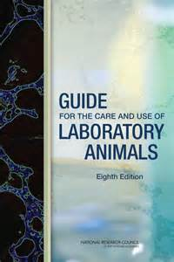
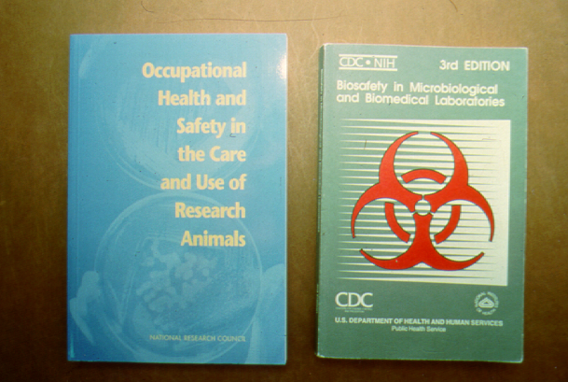
Team Tools
Animal Welfare Act and Animal Welfare Regulations
Guide for the Care and Use of Laboratory Animals
Guide for the Care and Use of Agricultural Animals in Research and Teaching
OLAW Guidelines for Oversight of Animal Activities in Satellite Facilities, Study Areas, Laboratories and Special Procedure Areas
Other references:
Occupational Health and Safety in the Care of Laboratory Animals
Biosafety in Microbiological and Biomedical Laboratories

Slide 9
Think - Pair - Share
What are you being asked to do?
Why are you being asked to do this?
Notes:
Separate participants into groups to discuss the questions. Groups can report out their answers. The facilitator or individual groups can record the answers on a white board.
What are you being asked to do?
Why are you being asked to do this?

Slide 10
Objective 2:
Perform an inspection

Slide 11
Start with the animals and work to the walls
Start with the Animals
and work to the Walls
Notes:
Start with the animals and work to the walls.

Slide 12
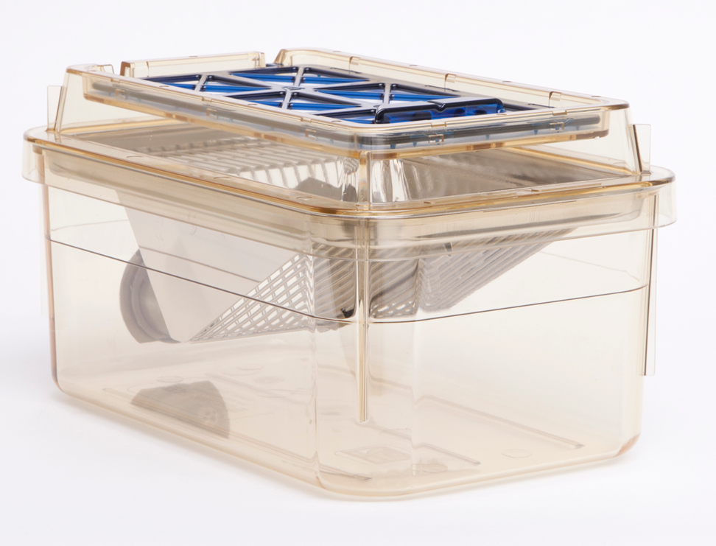
Microenvironment
(Primary Enclosure)
The physical environment immediately surrounding the animal
  a cage, pen or stall
Notes:
Cage density

Slide 13
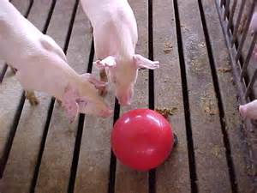
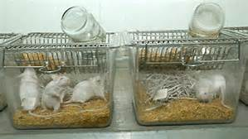
SHOUT OUT
Microenvironment
Notes:
What are things to note in these pictures?
What should the microenvironment include?

Slide 14
Microenvironment (Primary Enclosure)
The physical environment immediately surrounding the animal
  a cage, pen or stall
This enclosure should:
  Allow for normal physiologic and behavioral needs of the animal
  Allow easy access to food and water
  Provide adequate ventilation
  Allow animal to remain dry and clean
  Provide a secure environment free from sharp edges
  Be kept in good repair
  Include appropriate environmental enrichment
  Meet cage density standards

Slide 15
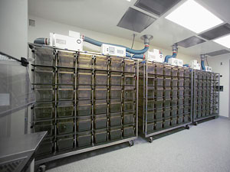
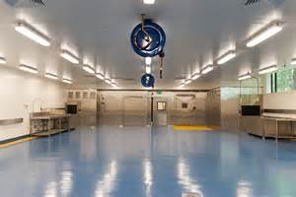
Macroenvironment
(Secondary Enclosure)
Physical environment of the room, barn or outdoor habitat of the research animals
Includes:
  Construction
  Cleanliness
  Temperature
  Humidity
  Ventilation rate
  Lighting
  Security
  Pest control
Notes:
What do you think you should check about a colony room or cage wash area.

Slide 16
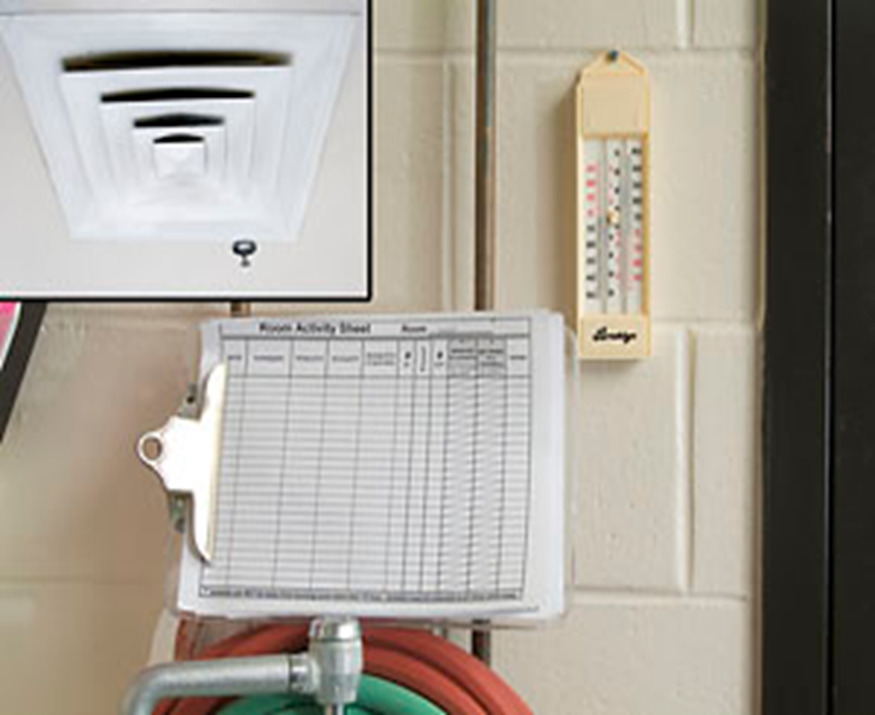
Virtual Walk Through
Notes:
Activity log completed?
What is the Temp/Humidity?
Is the air flowing?
Does it small okay?

Slide 17
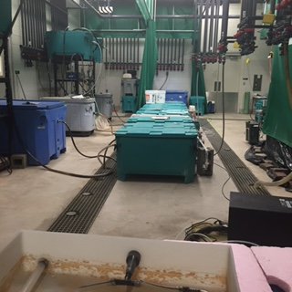
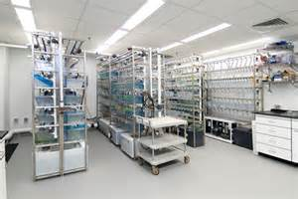
Fish Facility
Notes:
Guide
Cleanliness of room
Filter maintenance
Temp/Humidity
Water Temperature

Slide 18
Objective 3:
Identify deficiencies and categorize them

Slide 19
Deficiencies - Definition
USDA / PHS
A significant deficiency is defined as one that, in the judgment of the IACUC or the Institutional Official, is or may be a threat to the health or safety of animals.
  HVAC
  Electrical or watering systems
  Failure of such systems sufficient to affect critical housing and operational areas
  Situations such as natural disasters that cause injury, death, or severe distress to animals
A minor deficiency refers to a problem for which an immediate solution is not necessary to protect life or prevent distress.
  peeling or chipped paint
  Pests
  Improper signage
  Food barrel without a top
  Cluttered hallways
  PPE
Observation (optional) - items to note that were very good or not quite a deficiency, or an out of scope item
Notes:
From Animal welfare regulations § 2.31 –
If program or facility deficiencies are noted, the reports must contain a reasonable and specific plan and schedule with dates for correcting each deficiency. Not correcting a significant deficiency in the accordance to the plan is reportable to the USDA.
For USDA regulated facilities: Any failure to adhere to the plan and schedule that results in a significant deficiency remaining uncorrected shall be reported in writing within 15 business days by the IACUC through the Institutional Official, to APHIS and any federal agency funding that activity.

Slide 20
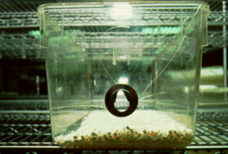
Microenvironment Pop Quiz:
What is Wrong?
What is wrong? This plastic shoe box cage, for housing rodents, is cracked (arrows)
Why is it wrong? It cannot be adequately sanitized.
What are you going to do? Cages in poor condition or repair should be disposed of and replaced as soon as possible.

Slide 21
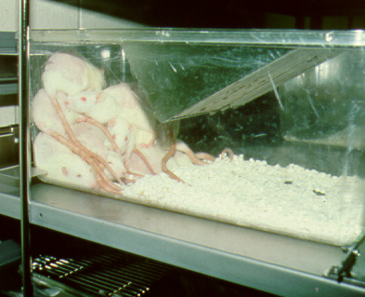
Microenvironment Pop Quiz:
What is Wrong?
What is wrong? Overcrowded cage.
Why is it wrong? Not enough room for normal animal behavior and physiological functions.
What are you going to do? Separate animals out for appropriate cage size to animal number ratio.
(Staged)

Slide 22
Objective 4:
Reporting findings / results and creating corrective action plans

Slide 23
Inspection findings
Types of information that it should contain
  “What, Why, What” Format
Information needed
  Building/Room number
  PI, Protocol Number or Facility Supervisor
  Thorough description of the issue
    Gives enough guidance to the responsible party
Notes:
The first “What” (in the “What, Why What” format) is addressed in the Inspection findings.
Ask the participants what kind of information should be included in the inspection finding.

Slide 24
Create corrective action plans
Types of information that it should contain
  “What, Why, What” Format
Information Needed
  Indicate why the deficiency is a deficiency
  Indicate what should be done to correct the deficiency
    Feasible
    Makes sense with the finding
    Gives enough guidance to the responsible party
Notes:
The “Why and What” (in the “What, Why What” format) is addressed in the corrective action plan.

Slide 25
Worksheet
With a partner / In a small group:
  Part 1: Circle the deficiencies with the best descriptions.
  Part 2: Match the appropriate corrective action plan with the circled deficiencies. Put the letter of the corrective action plan on the line next to the deficiency.
Large Group:
  Go through the worksheet once everyone has completed it.
Notes:
Pass out Objective 4 local facility inspection worksheet

Slide 26
Facility Inspection Concept Map
Exercise: Create a facility inspection concept map
What does the facility inspection:
  Address
  Evaluate
  Facilitate
  Results impact
Notes:
Facilitator may divide the participants into subgroups, each assigned with a category (Address, Evaluate, Facilitate, Results Impact)

Slide 27
Facility Inspection Concept Map
Facility Inspection
Address
Evaluate
Facilitate
Results Affect
Notes:
Groups can make a list of items pertaining to their category. They can write it on a white board and present it to the group or just read the list out-loud during a “Share” session.

Slide 28
Facility Inspection Concept Map
Facility Inspection
Address
Evaluate
Facilitate
Results Impact
Facility issues
Programmatic issues
Animal welfare concerns
Regulatory requirements
PAM
Animal welfare
Adherence to SOPs, Regs, Guide, Policies
Staff knowledge
Adequate staffing & resources
Security
Safety
Facilities management
Compliance
Communication w/ vet services, IACUC, PIs, IO, appropriate depts.
Recommendations for improvement
Animal welfare
Institution
IO / Senior Leadership
IACUC
PI & staff / students
Animal welfare
Research
Funding
Accreditation / Registration
Rank / Mission / Brand
Future recruitment
Animal program
Notes:
Animal Welfare is a common theme in each category, which is the root of the regulations requiring facility inspections.

Slide 29
Final (Summative) Test
  Activity option #1
Facilitator creates a mock facility area that IACUC members can inspect. IACUC members can perform the inspection on their own time and turn in their reports to the facilitator. At a later date, the facilitator can bring the learners back together to discuss the facility room and inspection reports.
  Activity option #2
Facilitator creates photos of problem facilities/facility areas. The learners can work individually, in pairs, or small groups. Learners create an inspection report based on the photo(s) they are given. Learners then share the report with the group.
  Activity option #3
Facilitator can provide information regarding the virtual tour noted in the Resources section of this manual to the learners. Learners can view the tour and create facility inspections reports based on the tour. At a later date, the facilitator can bring the learners back together to discuss the virtual tour and review the inspection reports.
Notes:
Hand out the Facility Inspection Report

Slide 30
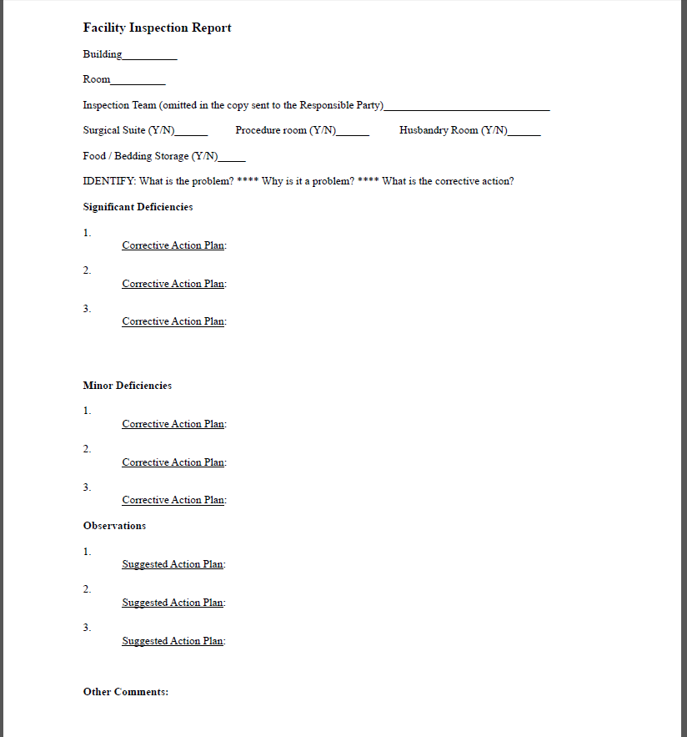
Facility Inspection Report
Notes:
This report form can be modified to better reflect the forms used at a given institution.

Slide 31
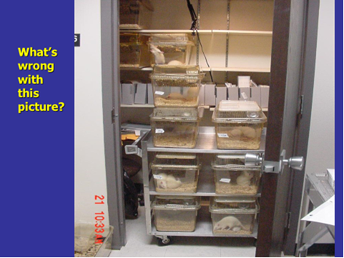
For Example: What’s wrong with this picture?
For Example:

Slide 32
What have you learned?
Defined responsibility of IACUC members
Performed an inspection
Identified and classified deficiencies
Created a report documenting the findings/results and a corrective action plan

